Slide 1




Loan Approval Prediction
PROJECT WORK ON MACHINE LEARNING
Presented To:
Prof. CLAUDIO SARTORI
Presented By:
Usha Padma Rachakonda(985891)
Academic Year: 2021-2022

Slide 2
Banking Organization deals in all loans
Whether the application is accepted or rejected.
To predict the possibility of payment of the loan by the customer.
In recent years, many researchers worked on loan approval prediction systems.
ABSTRACT

Slide 3
PRESENTATION OUTLINE
Introduction
Methodology
Data Collection
Analyzing Data
Data Cleaning
Model Building
Conclusion

Slide 4
Bank loans to fulfill their needs.
Loan applications increase at a very fast speed
Risk is always involved in the approval of loans
Automation of this process so that loan approval is less risky and less loss for banks
INTRODUCTION

Slide 5
METHODOLOGY
Analyzing Data
Univariate Analysis
Bivariate Analysis
Data Cleaning
Removing Missing Values
Outlier Treatment
Model Building
Logistic Regression
XGBoost
Data Collection
Random Forest
Decision Tree
Evaluating Performance Metrics of Models
Accuracy
Precision
Recall

Slide 6
Gathering and measuring information from different sources.
The basis of the training data set is 13 features in total.
Out of all 12 are independent variables and 1 is the dependent variable
The dependent variable is Loan_Status.
DATA COLLECTION

Slide 7
It is a process of cleaning, transforming, and modeling data.
Data Analysis
Univariate Analysis
Bivariate Analysis
ANALYSING DATA

Slide 8
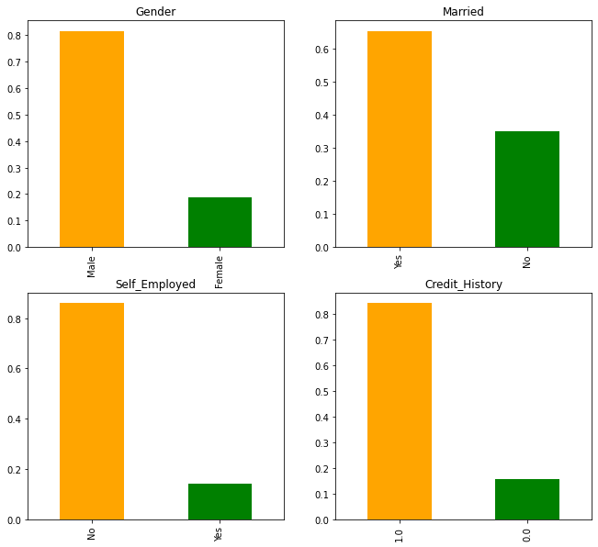
UNIVARIATE ANALYSIS
80% of loan applicants are male.
Nearly 70% are married.
85–90% of loan applicants are not self-employed.
Nearly 85% of people have a Credit History.

Slide 9
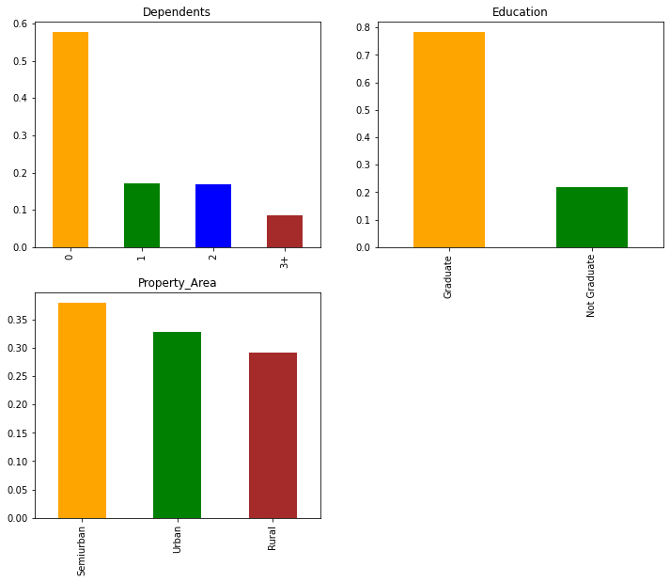
Categorical features(Ordinal)
* Almost 58% of the applicants have no dependents.
* About 75% are graduates.
* Most of the applicants reside in Semi-urban areas.

Slide 10
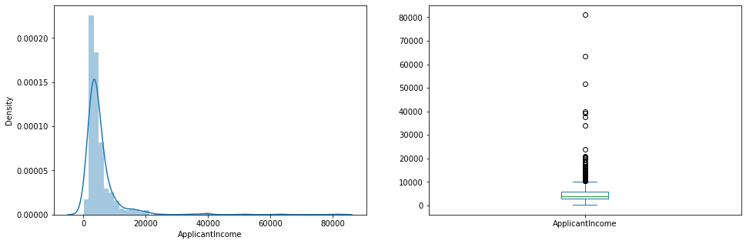
Numerical features(Ratio)
Applicant Income:
* In this data Applicant’s income is towards the left which means it is not normally distributed.

Slide 11
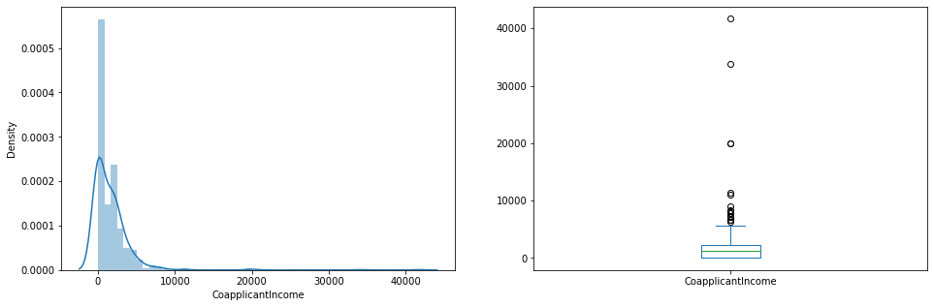
Co-applicant Income:
* In this data lesser than applicant income and is within the 5000–15000, again with some outliers

Slide 12
In this analysis is finding the empirical relationship between two variables.
Specifically, the dependent vs independent variables.
BIVARIATE ANALYSIS

Slide 13
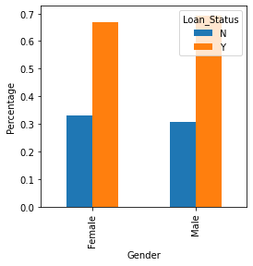
Categorical Independent Vs Target
Gender Vs Loan_Status
* There is not a substantial difference between male and female approval rates.

Slide 14
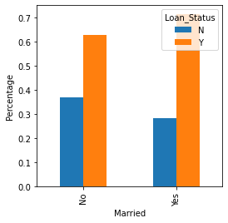
Marriage Status Vs Loan_Status
* Married applicants have a slightly higher chance of loan approval.

Slide 15
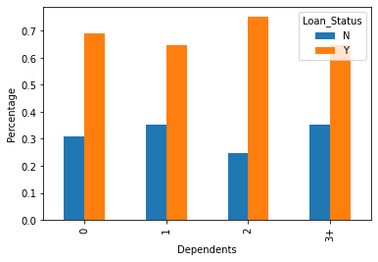
Dependency Vs Loan_Status
* Applicants with no dependents or 2 dependents have higher chances of approval.

Slide 16
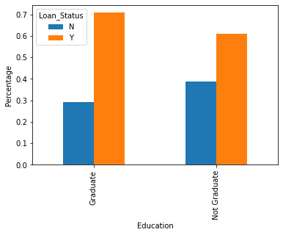
Education Vs Loan_Status
* Graduates have a higher chance of loan approval compared to non-graduates.

Slide 17
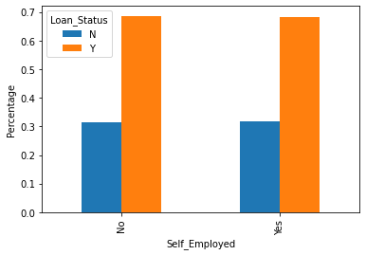
Self Employed Vs Loan_Status
* Self_Employed employees have slightly lower chances of loan approval but the situation is not that bad

Slide 18
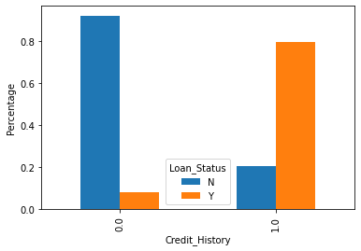
Credit History Vs Loan_Status
* It seems people with a credit history of 1 are more likely to get their loans approved.

Slide 19
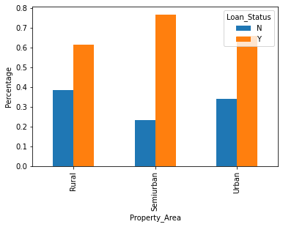
Property Area Vs Loan_Status
* Loans getting approved in semi-urban areas are higher as compared to those in rural or urban areas.

Slide 20
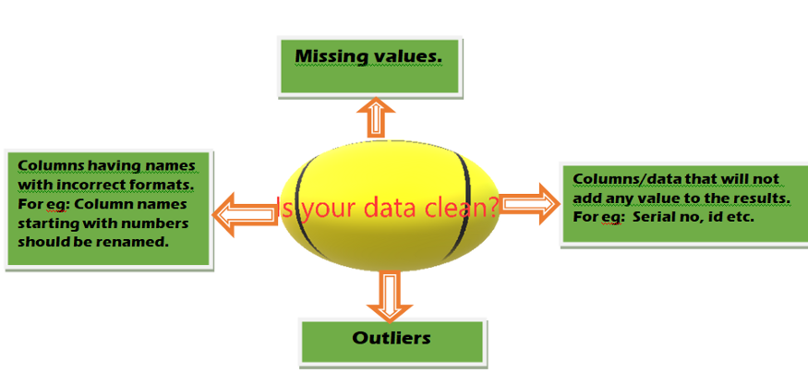
DATA CLEANING

Slide 21
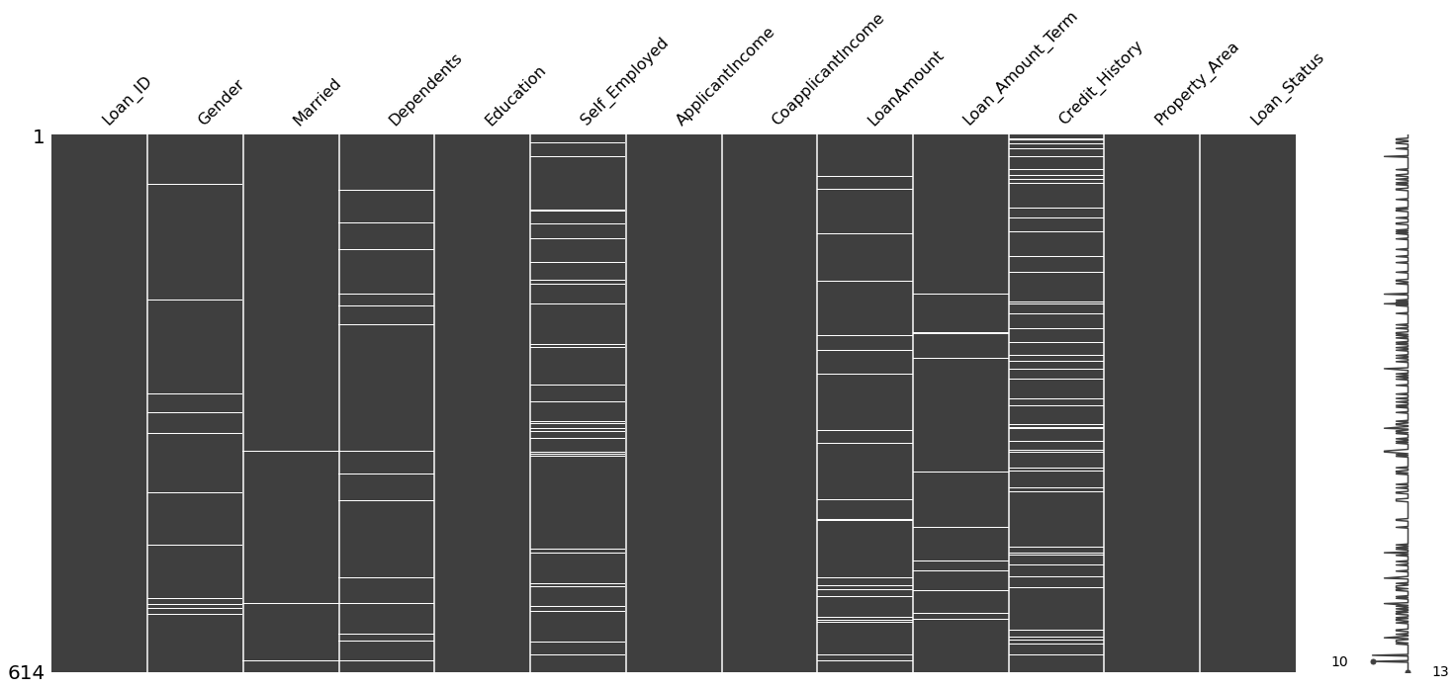
Missing Values Imputation
* Categorical variables replace with mode.
* Numerical variables with their mean

Slide 22
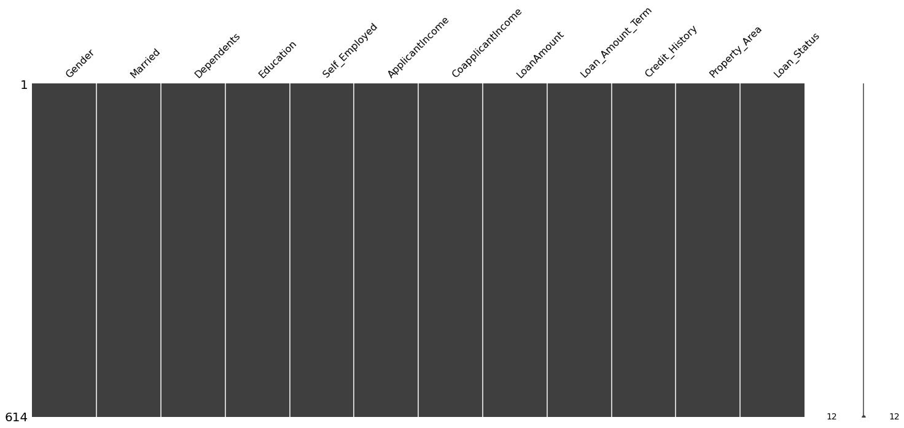
Result of Missing Values Imputation

Slide 23
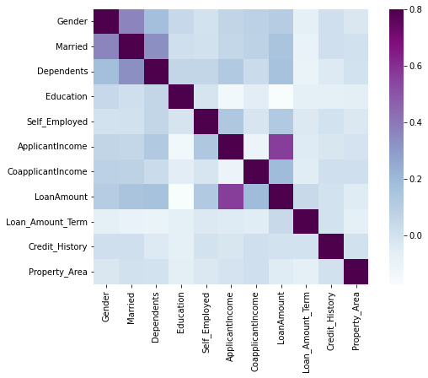
Visualizing correlation via Heatmap
* Loan Amount is correlated with Applicant Income 56%
* Loan Amount is correlated with Co-applicant Income 18%

Slide 24
Outlier Treatment
* A data point that is noticeably different from the rest
* Can be generated by
* Noise rare events/processes
* Here the red points show the abnormal behavior

Slide 25
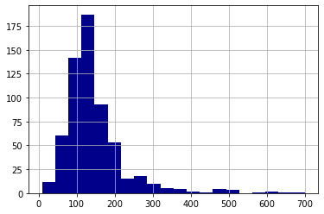
* Distribution of Loan Amount.
* Outliers in the Loan Amount.
* Bulk of data towards left.

Slide 26
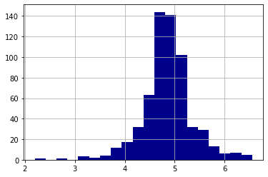
* Remove this skewness by doing a log transformation
* Distribution becomes normal

Slide 27
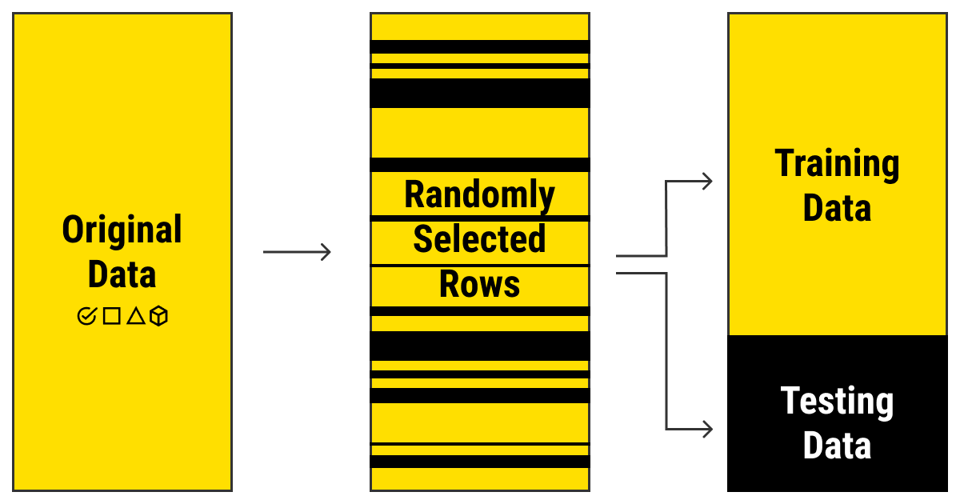
Training And Testing
* The data using the train_test_split into 80% Training and 20% Testing.

Slide 28
Model Building
Logistic Regression
Decision Tree
Random Forest
XGBoost
* Models To Predict the loan approval

Slide 29
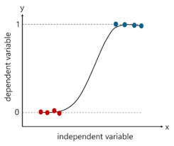
Logistic Regression
* Classification algorithm.
* Logistic function to predict binary outcome (True/False, 0/1, Yes/No).
* Logit function develops an s-shaped curve with the probability estimate.

Slide 30
Accuracy: 0.80
Precision for N class: 0.89
Precision for Y class: 0.78
Recall for N class: 0.41
Recall for Y class: 0.98
F1 score for N class: 0.56
F1 score for Y class: 0.87
Evaluation of Logistic Regression

Slide 31
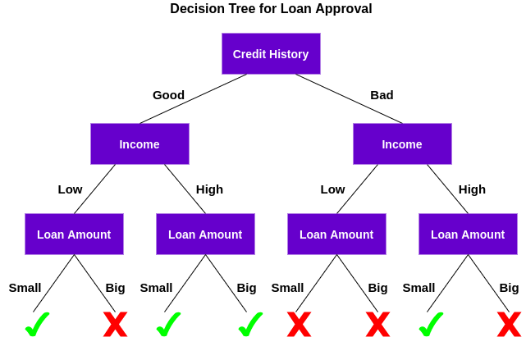
Decision Tree
* Classification and Regression Model.
* Predict the Target Variable.
* Best parameter - RandomdSearchCV

Slide 32
Accuracy: 0.80
Precision for N class: 0.94
Precision for Y class: 0.78
Recall for N class: 0.41
Recall for Y class: 0.99
F1 score for N class: 0.57
F1 score for Y class: 0.87
Evaluation of Logistic Regression

Slide 33
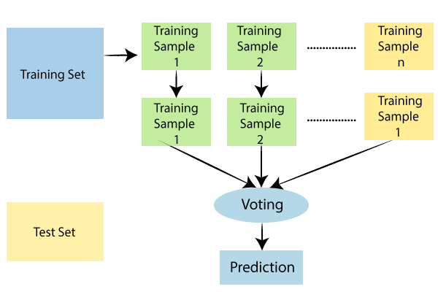
Random Forest
* Classification and Regression Model.
* Predict the Continuous Variables.
* Ensemble technique.

Slide 34
Accuracy: 0.79
Precision for N class: 0.88
Precision for Y class: 0.77
Recall for N class: 0.38
Recall for Y class: 0.98
F1 score for N class: 0.54
F1 score for Y class: 0.86
Evaluation of Random Forest

Slide 35
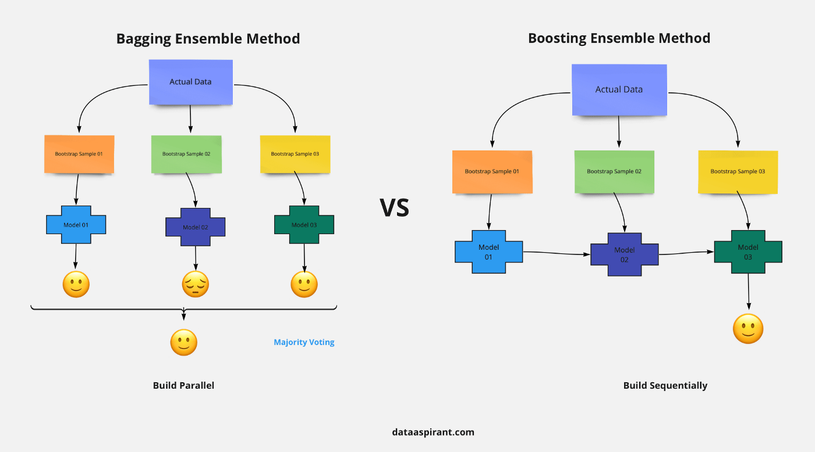
XGBoost(Extreme Gradient Boosting)
* Classification and Regression Model.
* It is a scalable, distributed gradient-boosted decision tree (GBDT).
* Speed and Performance.

Slide 36
Accuracy: 0.77
Precision for N class: 0.69
Precision for Y class: 0.80
Recall for N class: 0.51
Recall for Y class: 0.89
F1 score for N class: 0.59
F1 score for Y class: 0.84
Evaluation of XGBoost

Slide 37
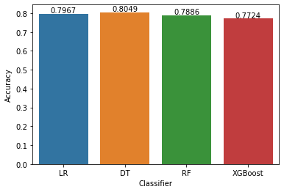
Accuracy
The ratio of true positives and true negatives to all positive and negative observations.
Accuracy Score = (TP + TN)/ (TP + FN + TN + FP)

Slide 38
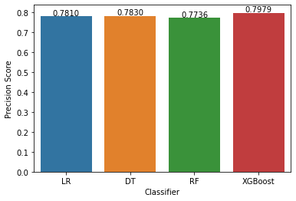
Precision
Ability to correctly predict the positives out of all the positive predictions it made.
The ratio of true positive to the sum of true positive and false positive.
Precision Score = TP / (FP + TP)

Slide 39
Recall
Predict the positives out of actual positives.
The ratio of true positive to the sum of true positive and false negative.
Recall Score = TP / (FN + TP)

Slide 40
Best Performer – Logistic Regression and Decision Tree.
Worst Performer - XGBoost
Conclusion

Slide 41
THANK YOU

